Slide 1

CANADA Holiday Customs and Work Ethics
By –
Anwesha Das
Agnibha Chandra

Slide 2
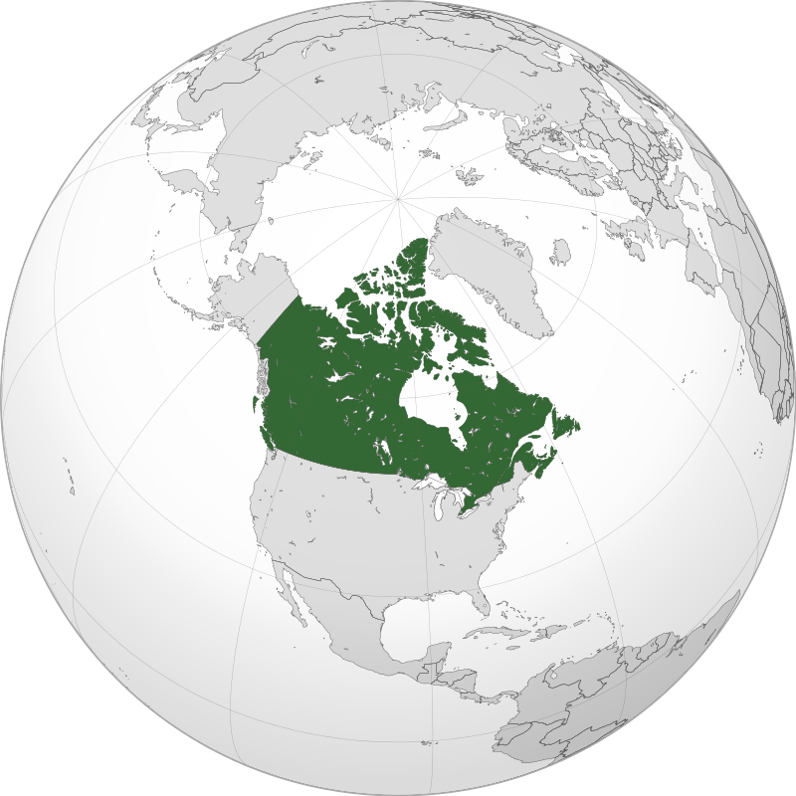
About Canada
Continent : North America
Capital : Ottawa
Area : 9.985 million km² ( Second Largest Country))
Population : 3.76 crores (Sparsely Populated)
Official Language : English ,French

Slide 3
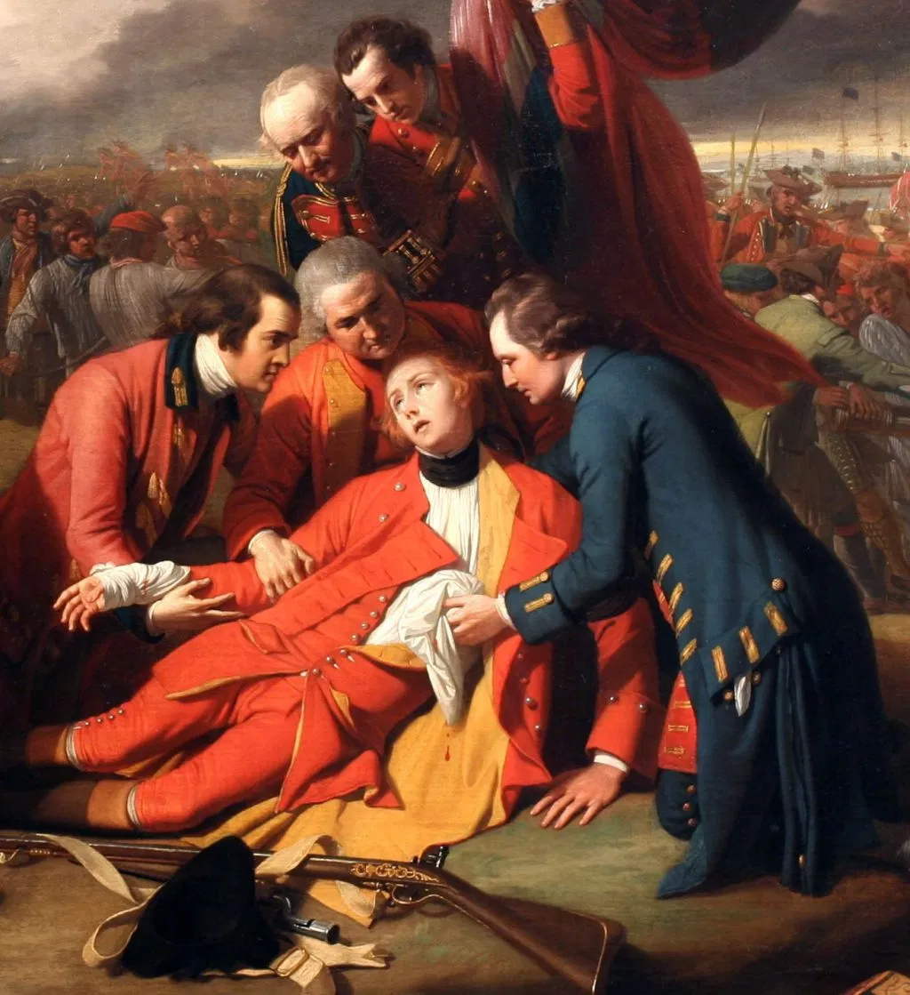
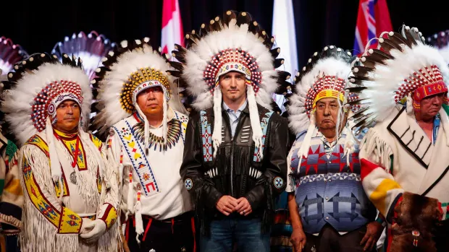
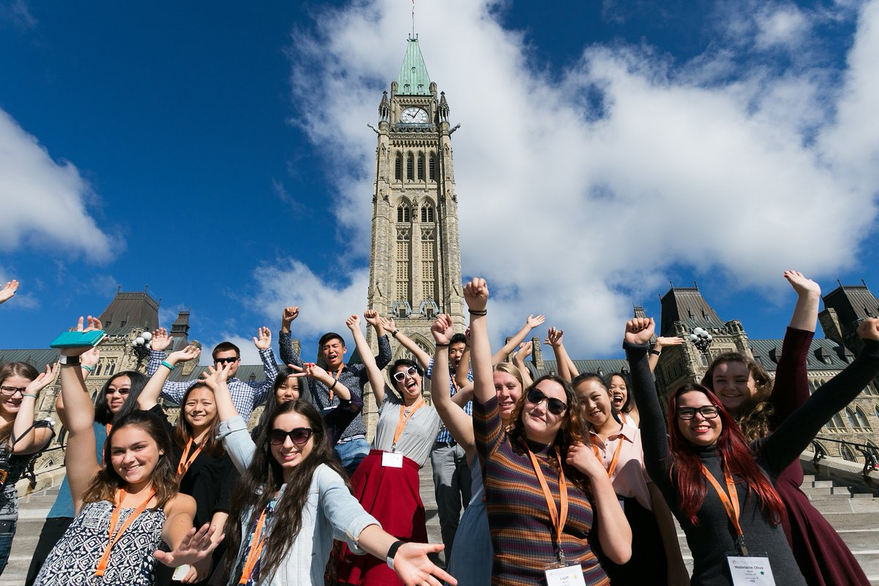
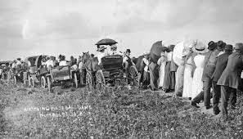
Reason of Diversified Culture
Indigenous peoples
European colonization
Confederation and expansion
Early 20th century
Contemporary era

Slide 4
ETHNIC GROUPS

Slide 5
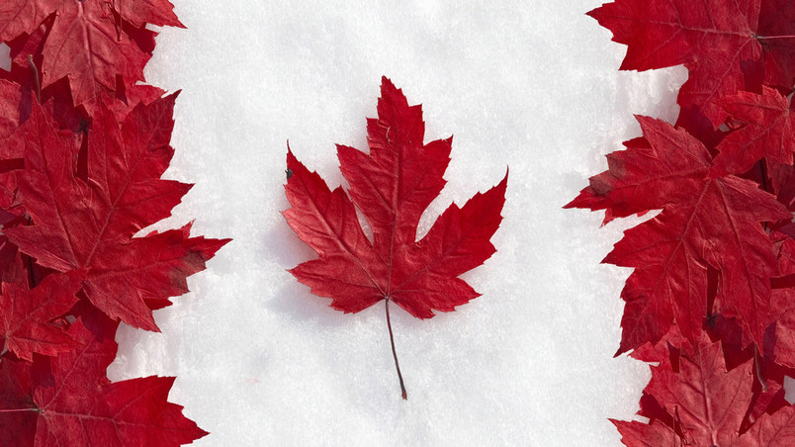
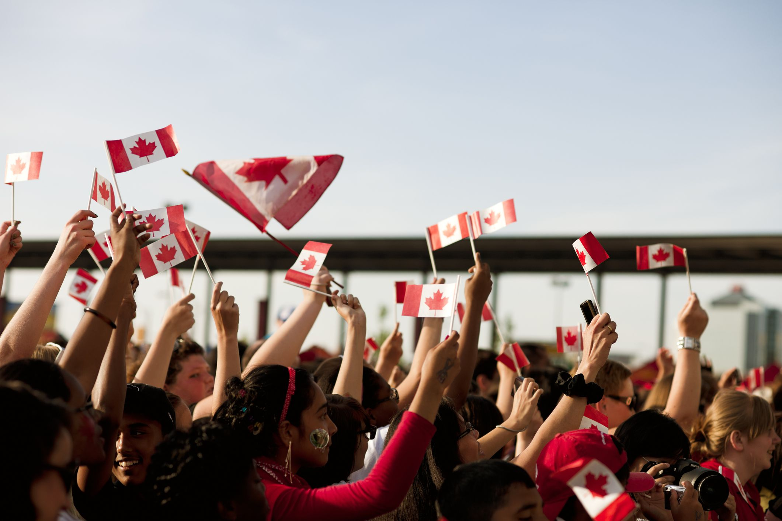
Holiday CUSTOMS
New Year's Day
Good Friday (or Easter Monday);
Victoria Day (variously known as May 24th, the Queen's Birthday, Empire Day or Commonwealth Day) is celebrated in all provinces except Québec (where it is celebrated as Fête de Dollard)
Canada Day (formerly called Dominion Day)
Labour Day
Thanksgiving Day
Remembrance Day
Christmas Day
Boxing Day.

Slide 6
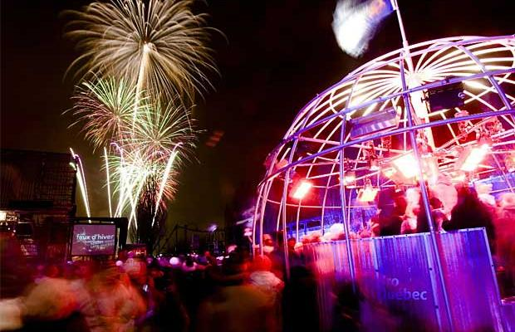
Holiday Traditions

Slide 7




WORK ETHICS
Equality
Punctuality
Individualism
Informality
Going beyond the basics
Professional communication

Slide 8
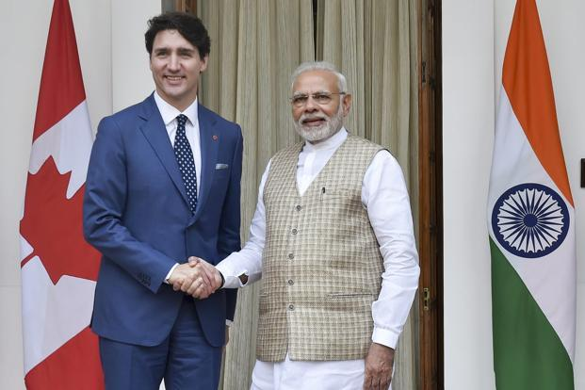
WORK CULTURE
Greetings
Formal
Informal
Abiding by Laws
neighbors are often very vigilant about rules.
Multi cultural
necessary to develop an understanding for behavioural patterns and sensitivity of workers with very different ethnic backgrounds.

Slide 9


